Slide 1
Employee Travel Policy
AP 7400
Revised 2025

Slide 2
Content Covered Today
Travel Guidelines
Required Approval
Summary of Reimbursable Expenses
Summary of Non-Reimbursable Expenses
Student Travel
Field Trip Travel

Slide 3
Travel Guidelines
Overall Guidelines to keep in mind when requesting travel.

Slide 4
Travel Guidelines
All Travel requests require the approval of the immediate supervisor, department Vice President, and Superintendent/President prior to the employee traveling.
Any travel request outside the United States requires Board of Trustee approval.
Employees are expected to exercise prudent judgment when incurring travel expenses. Excess & unnecessary expenses will not be approved or reimbursed.

Slide 5
Travel Guidelines
Expenses should be paid by the employee and reimbursed by the District. Receipts are required for all reimbursable charges, except for meals.
Employees may be required to submit a trip report along with their final claimed expenses.
Employees who cannot attend are responsible for canceling lodging, conference registration, and airfare. Failure to comply could result in personal liability for all non-cancelled charges.

Slide 6
Required Approval
Steps required to achieve an active travel status.

Slide 7
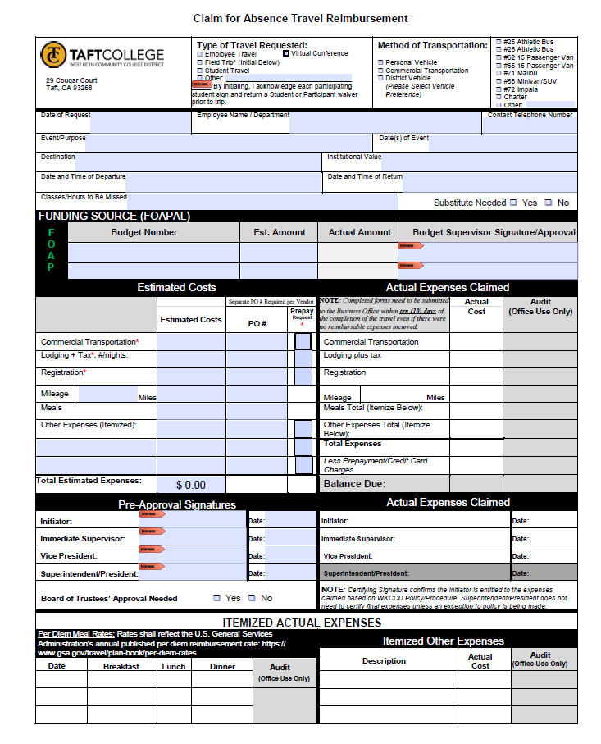
Claim for Absence / Travel Reimbursement Form
Form uses:
Absence Request Form
Travel Reimbursement Claim Form
Transportation Request Form

Slide 8
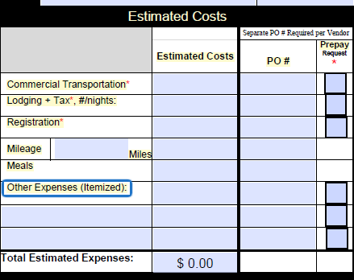
Step #1 – Estimated Costs Approvals
Initiator will complete the Claim for Absence Travel Reimbursement form and request estimated costs to both their immediate supervisor, the department’s Vice President, and the Superintendent/President for initial approval.
If requesting advanced payment for conference fees, lodging, and transportation, it will need to be indicated on the travel form by checking the “Prepay Request” box. Final approval must be submitted to the Business Office at least 30 days in advance of the travel to allow for processing.
It will be necessary to attach all pertinent backup documents with the travel form for initial approval.

Slide 9
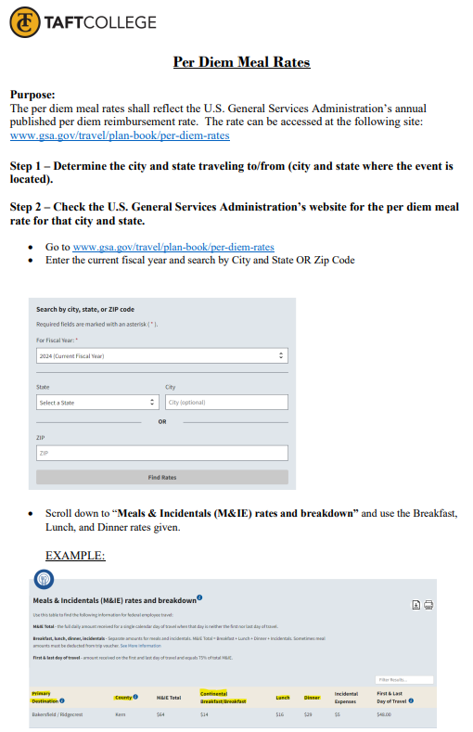
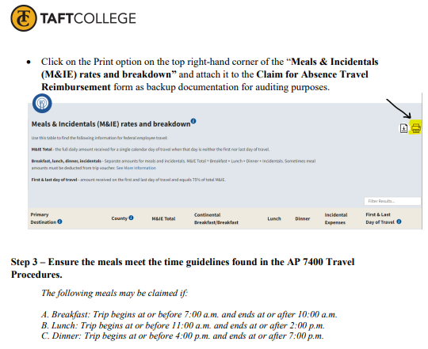
Per Diem Meal Rates can be estimated by using the rates reflecting the U.S. General Services Administration’s annual published per diem reimbursement rate.

Slide 10
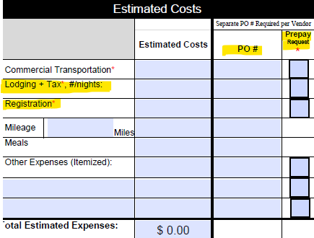
Step #2 – Estimated Costs Approvals
Purchase orders must be submitted in Banner for the estimated costs being requested. PO #’s need to be indicated on the form.
NOTE: A Purchase Order needs to be created for each vendor to be paid IF you are requesting prepayment. For example:
PO #1 – Hotel (Prepayment Requested)
PO #2 – Registration (Prepayment Requested)
PO #3 – Employee Traveling (Meal & Mileage Reimbursement)
The “Claim for Absence / Travel Reimbursement” form is required even if expenses are not expected to be incurred.

Slide 11
Step #3 – Estimated Costs Approvals
Approved travel forms with appropriate documentation are to be forwarded to the Superintendent/President’s office for final approval prior to the date of the trip.
If traveling outside the United States, Board approval is required.
Approved travel packets will be forwarded to the Business Office.

Slide 12
Step #4 – Estimated Costs Approvals
The Business Office will process any advanced payment requests if received within 30 days of travel & purchase orders have been submitted.
If requesting a District Vehicle, the Business Office will forward a copy of the approved travel request form to M&O for processing. The District Vehicle box must be checked under Method of Transportation.
The Business Office will return the approved original “Claim of Absence / Travel Reimbursement” packet to the employee traveling. The form must be returned to the Business Office after travel has been completed.
NOTE: Until the employee receives the original form back, their travel has not been fully processed & approved.

Slide 13
Submitting for Reimbursement

Slide 14
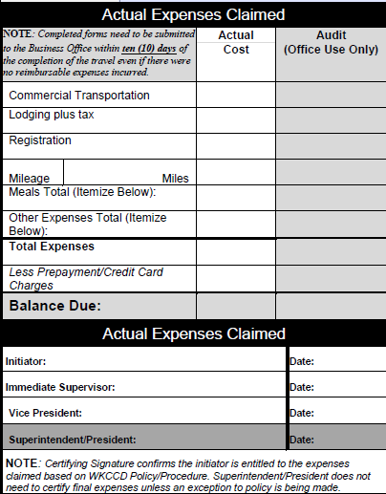
After Completed Travel
After travel has been completed, the employee must record actual expenses incurred within the Actual Expenses Claimed section of the original “Claim of Absence / Travel Reimbursement” form.
All necessary receipts and backup are required for all reimbursable charges except for meal per diem.
Employee, supervisor, and Vice President must approve all final expenses.
Forms must be returned to the Business Office within ten (10) working days after travel has been completed.
No reimbursements for prior fiscal year claims will be processed after July 10th of the succeeding fiscal year.
NOTE: Even if expenses were not incurred, the form must be submitted indicating travel has been completed.

Slide 15
Receipts and Back Up Documentation
Lodging – Detailed folio from hotel. The guest’s name must match the employee requesting personal or credit card reimbursement.
Mileage – Map indicating total miles traveled.
Meals – Can be claimed if not included in the attended conference/workshop.

Slide 16
Summary of Reimbursements

Slide 17
Meal Per Diem
Per Diem Meal Rates can be estimated by using the rates reflecting the U.S. General Services Administration’s annual published per diem reimbursement rate.

Slide 18
Ground Transportation
District/Personal Vehicle:
Use of a District fleet vehicle is encouraged but not mandatory.
Transportation method must be indicated on the travel request form.
District Vehicles – Gas Expenses are reimbursed if the District gas card is not used (Receipts Required)
Personal Vehicles – Mileage is paid at the current approved IRS rate (Round trip Mileage Route Map required).
Rental Car:
Use of a rental vehicle must be itemized on the travel request form. (Receipts required).
Public Transportation:
Taxi, bus, ferry, shuttle, metro fares, and other forms of public ground transportation are reimbursable when it is necessary. (Receipts required).

Slide 19
Air Transportation
Lowest available airfare in coach or economy class tickets that reasonably meets District travel needs for domestic and international flights.
Encouraged to book flights at least 14 days in advance to avoid premium pricing.
Non-Reimbursable:
Upgraded seating resulting in a higher-priced coach ticket.
Additional costs associated with changing the originally booked ticket for the convenience of the employee.

Slide 20
Lodging
Allowable when travel is forty (40) miles or more from the traveler’s home or primary worksite.
Reasonable, single occupancy, standard business room rates, or limited to conference room rate when the conference provides hotel rates.
Lodging costs only for the appropriate and reasonable amount of time to conduct official business will be reimbursed.

Slide 21
Summary of Non -Reimbursements

Slide 22
Some Examples Include:
Reimbursable expenses without proper receipts and documentation.
Alcoholic beverages.
Entertainment expenses, movie rentals, and other luxury items similar in nature.
Upgrades to hotel rooms and airfare.
Traffic or parking citations.
Lodging in excess of the reasonable time to travel to and from the meeting destination to conduct official business.
Dining expenses when such meals are included in the conference or meeting fee.

Slide 23
Other Travel Types

Slide 24
Student Travel:
A student who is traveling on behalf of the District shall follow the same parameters set for a District employee.
The Student is also required to sign and submit a “Student or Participant Waivers” form to the appropriate Vice President or designee prior to the travel date.

Slide 25
Field Trip Travel:
Field trips shall follow the same parameters set for a District employee travel requirements except in regards to the following:
Transportation reimbursements are only eligible with an approved District vehicle request. If a student elects to use their personal vehicle as a mode of transportation, mileage may not be claimed.
Field Trips are ineligible for a claim for meal per diem rates.
All students participating must sign and submit a “Student or Participant Waivers” form to the appropriate VP prior to the travel date.
Only students, faculty, and TC employees associated with the course names on the field trip may attend the excursion.

Slide 26
THANK YOU!
Administrative Services/Fiscal Services
Phone
661-763-7853

